Slide 1
Nublu System Description
By: Edward Nava

Slide 2
Nublu
Concept of operations – resource access and virtual machine instantiation is a function of user authorization, operating context, and usage policies.
Usage Management System:
Controls the initial resource access and cloud computing system provisioning.
Monitors the resource security parameters, cloud computing resource security characteristics, and operator context to provide continuous control.

Slide 3
Operation – Initial Configuration
User Identification and context checking
2
Data Link 1 SC{H,H,L}
Data Link 2 SC{L,L,H}
Data link 3 SC{L,L,L}
Data link 4 SC{H,H,L}
Data link 5 SC{H,H,H}
Data link 6 SC{H,H,H}
1
3
User
&
Context
4
Public Cloud
5
SC{L,L,H}
SC{L,M,H}
SC{L,H,H}
Usage
Management
System
Private Cloud
SC{H,H,H}
SC{H,M,L}
SC{H,L,L}

Slide 4
Operation – Dynamic Re-Configuration 1
1
User Identification and context checking
Data Link 1 SC{H,H,L}
Data Link 2 SC{L,L,H}
Data link 3 SC{L,L,L}
Data link 4 SC{H,H,L}
Data link 5 SC{H,H,H}
Data link 6 SC{H,H,H}
SC Changes
To SC{H,L,H}
User
&
Context
2
Public Cloud
3
SC{L,L,H}
SC{L,M,H}
SC{L,H,H}
Usage
Management
System
4
Private Cloud
SC{H,H,H}
SC{H,M,L}
SC{H,L,L}

Slide 5
Operation – Dynamic Re-Configuration 2
User Identification and context checking
Data Link 1 SC{H,H,L}
Data Link 2 SC{L,L,H}
Data link 3 SC{L,L,L}
Data link 4 SC{H,H,L}
Data link 5 SC{H,H,H}
Data link 6 SC{H,H,H}
User
&
Context
2
1
Context
Changes
Public Cloud
SC{L,L,H}
SC{L,M,H}
SC{L,H,H}
Usage
Management
System
Private Cloud
3
SC{H,H,H}
SC{H,M,L}
SC{H,L,L}

Slide 6
Operation with Usage Management
Amazon S3
Joe, B
1
UMM
3
Bucket | Data | Metadata
ECE | D1(A) | D1m
D2(B) | D2m
D3(C) | D3m
Informatics | DI1(B) | DI1m
DI2(B) | DI2m
DI3(C) | DI3m
User & Context
4
Access Control DB
Person | Password | Context
Joe | XXX | A
Joe | XXX | B
Bill | XXY | B
Tom | XXZ | A
5
2
Cloud A
6
Usage Management Framework controls use of the resource within the VM environment
Level{A}
Level{B}
Level{C}
7
Cloud B
Level{A}
Level{B}
Level{C}

Slide 7
Operation – Dynamic Re-Configuration 3
1
User Identification and context checking
Data Link 1 SC{H,H,L}
Data Link 2 SC{H,L,L}
Data link 3 SC{L,L,L}
Data link 4 SC{H,H,L}
Data link 5 SC{H,H,H}
Data link 6 SC{H,H,H}
SC Changes
To SC{L,L,L}
User
&
Context
2
Public Cloud
4
SC{L,L,H}
SC{L,M,H}
SC{L,H,H}
Usage
Management
System
3
Private Cloud
SC{H,H,H}
SC{H,M,L}
SC{H,L,L}

Slide 8
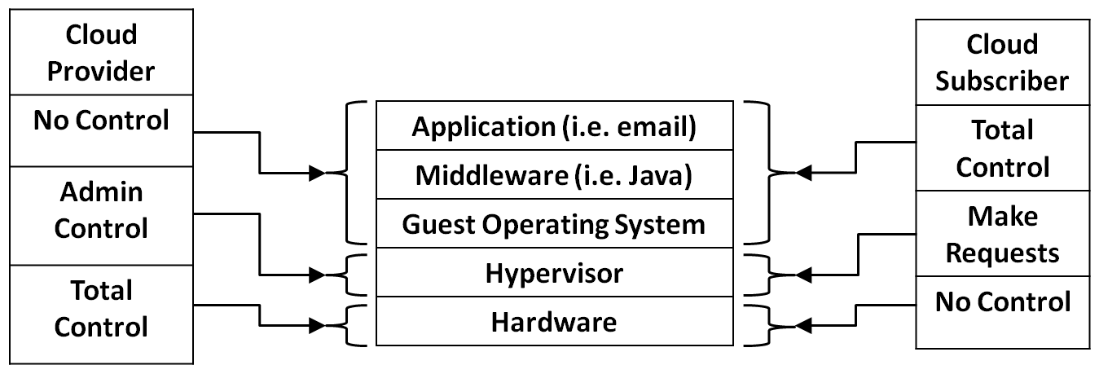
Span of Control - IaaS

Slide 9
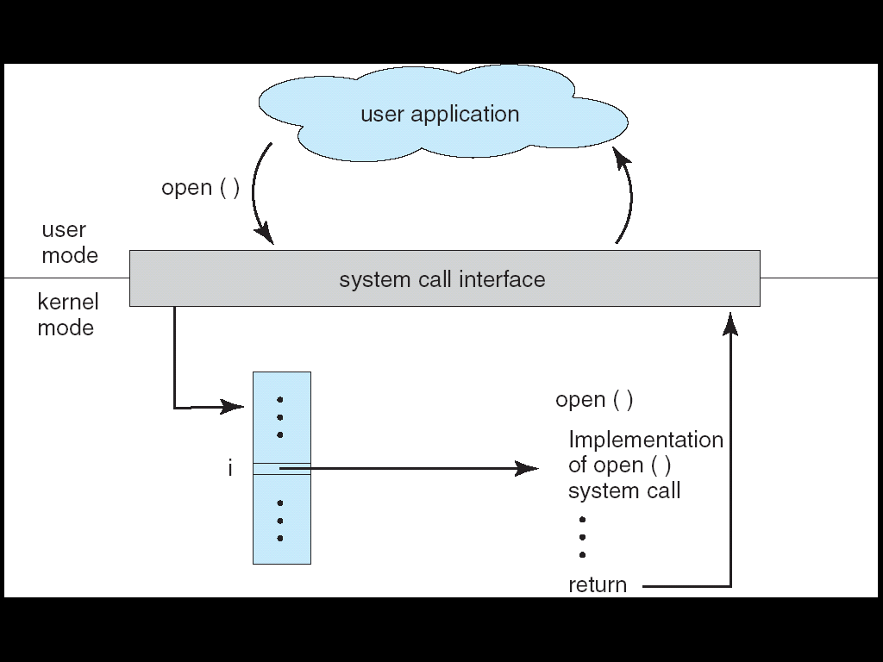
Application Software and OS Interaction
Potential Point of Control

Slide 10
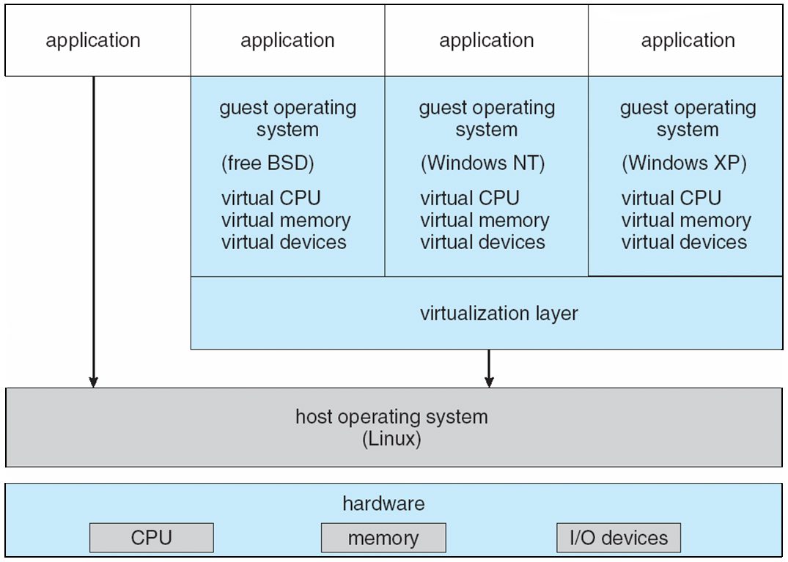
Layering with VMWare
Potential Point of Control

Slide 11
Key Considerations
The interfaces between the application and operating system, and between the operating system and the hardware, lend themselves to the introduction of control functions.
It is highly undesirable to modify the operating system itself because of the size and complexity.
It is also undesirable to modify application software.
Hardware components like the TPM can provide extremely useful capabilities in private cloud environments.

Slide 12
More Considerations
Encryption is a key element in information security.
Partially homomorphic encryption can be useful in some applications, but is not a universal solution.
Isolation methods using nested virtualization are very useful.
Key management procedures and certificates will be essential.

